Slide 2
8
Income Streams
There are eight different income streams available to each
Unicity Franchise Partner:
Retail Profit
Personal Rebate
Fast Start Bonus
Director Lifestyle Bonus

Slide 3
8
Income Streams
There are eight different income streams available to each
Unicity Franchise Partner:
Infinity Bonus
President’s Club Bonus
Additional Franchise Positions
Chairman’s Club Bonus

Slide 4
1
Profit Center
Retail Profits
Earn money selling Unicity products
Earn $40 - Cleanse

Slide 5
1
Profit Center
Retail Profits
Earn money selling Unicity products
Earn $45 - Balance

Slide 6
1
Profit Center
Retail Profits
Earn money selling Unicity products
Earn $25 - Complete

Slide 7
1
Profit Center
Retail Profits
Earn money selling Unicity products
Earn $40 - Matcha

Slide 8
Term Definition
Points
Because of differences in global currencies, Unicity’s products have been assigned a point value. All rank advancements and earnings are based on points.
Examples:
• Cleanse 50 points - $70 wholesale
• Balance 52 points - $75 wholesale
• Matcha 50 points - $70 wholesale
• Complete 25 points - $50 wholesale

Slide 9
Term Definition
Personal Volume or PV
PV is the sum total of your orders with Unicity and the orders placed by your customers directly with Unicity during a commission month.
You
(100 PV)
Customer #1
(50 PV)
Customer #2
(50 PV)
Customer #3
(50 PV)
Your total PV in this example is 250 PV

Slide 10
2
Profit Center
Personal Rebates
Build a growing customer base and earn volume discounts
Personal Volume (PV) | Rebate % Earned
100 - 999 | 5%
1,000 – 2,499 | 15%
2,500+ | 20%

Slide 11
Term Definition
Team Volume or TV
TV is the sum total of your PV and all your frontline partners PV. (No Cap)
Jr. Manager
500 TV
Manager
1000 TV
*Read compensation plan for rules and qualifications.

Slide 12
3
Profit Center
Fast Start Bonuses (Jr. Manager)
Advance rank and earn bonuses on those you enroll during their first month
Team Volume (TV) | Rank | % Earned
500 Points | Jr. Manager | 15%
You
(250 PV)
Maria
(250 PV)
In this example your PV plus Maria’s PV equals 500 (TV). You are now a Jr. Manager and earn 15% on Maria’s PV.

Slide 13
3
Profit Center
Fast Start Bonuses (Manager)
You enroll three people during the same month with 250 PV each.
Team Volume (TV) | Rank | % Earned
1000 Points | Manager | 30%
You
(250 PV)
Maria
(250 PV)
Joe
(250 PV)
Jose
(250 PV)
1000 TV qualifies you as a Manager and you earn 30% or $225.
Fast Start Bonuses are paid weekly in most countries.
*Read compensation plan for rules and qualifications.

Slide 14
Get Your Money Back Fast
Buy 5 Unicity Cleanse – 250 PV and $350
Use 1 and Sell 4 = $440
Profit $90, plus your free cleanse system

Slide 15
Get Your Money Back Fast
Buy 5 Unicity Balance – 260 PV and $375
Use 1 and Sell 4 = $480
Profit $105, plus your Balance free

Slide 16
Get Your Money Back Fast
Buy 5 Unicity Matcha – 250 PV and $350
Use 1 and Sell 4 = $440
Profit $90, plus your Matcha free

Slide 17
3
Profit Center
Fast Start Bonuses (Jr. Manager)
 | Jr. Manager (One-Time 500 TV) | Manager (One-Time 1000 TV)
Enroller | 15% | 30%
Enrollers Sponsor | 3% | 3%
Director | 3% | 3%
Senior Director | 3% | 3%
Executive Director | 3% | 3%
Presidential Director | 3% | 3%
Presidential Sapphire | 3% | 3%
Presidential Ruby | 3% | 3%
Presidential Diamond | 5% | 5%
*Read compensation plan for rules and qualifications.

Slide 18
Term Definition
Organizational Volume or OV
OV is the sum total of all the points being generated by your entire organization to infinity.
OV is used to calculate points for rank advancements.

Slide 19
4
Profit Center
Director Lifestyle Bonuses
Earn monthly bonuses based on your rank.
Title | *Six-Month Bonus | *Qualifications
Senior Manager | $200 a month | 2,000 OV
Director | $500 a month | 5,000 OV
Senior Director | $1000 a month | 10,000 OV
Executive Director | $1500 a month | 25,000 OV
Total | $3,200
*Read compensation plan for rules and qualifications.

Slide 20
New Bonus!
Senior Manager Bonus
You
(500 PV)
Rank:
Sr. Manager (2000 OV)
Maria
(500 PV)
Joe
(500PV)
Jose
(500 PV)
Month 1 Earnings: $650
$450 in Fast Start Bonuses
$200 in Senior Manager Bonuses

Slide 21
5
Profit Center
Infinity Share Bonuses
*Earn up to nine shares of Infinity Bonuses
Rank | Manager | Senior Manager | Director | Senior Director | Executive Director | Presidential Director | Presidential Sapphire | Presidential Ruby | Presidential Diamond
Generation
1 | 5% | 5% | 5% | 5% | 5% | 5% | 5% | 5% | 5%
2 |  | 5% | 5% | 5% | 5% | 5% | 5% | 5% | 5%
3 |  |  | 5% | 5% | 5% | 5% | 5% | 5% | 5%
4 |  |  |  | 5% | 5% | 5% | 5% | 5% | 5%
5 |  |  |  |  | 5% | 5% | 5% | 5% | 5%
6 |  |  |  |  |  | 5% | 5% | 5% | 5%
7 |  |  |  |  |  |  | 5% | 5% | 5%
8 |  |  |  |  |  |  |  | 5% | 5%
9 |  |  |  |  |  |  |  |  | 5%
*Read compensation plan for rules and qualifications.

Slide 22
6
Profit Center
Presidential Club Bonuses
*Earn bonuses based on your rank.
Title | Bonus | *Qualifications
Presidential Director | $2000 x 6 months | 50,000 OV
Presidential Sapphire | $3000 x 6 months | 100,000 OV
Presidential Ruby | $4000 x 6 months | 150,000 OV
Presidential Diamond | $50,000 lump sum | 250,000 OV
*Read compensation plan for rules and qualifications.

Slide 23
7
Profit Center
Additional Distributor Positions (ADP)
Build Additional Franchise Positions (ADP) and earn 2X, 3X and even 4X on your volume.*
First Position
Diamond Distributor Position
Double Diamond Distributor Position
Triple Diamond Distributor Position
Crown Diamond Distributor Position
Leg 1
5000
Leg 2
5000
Leg 3
5000
AFP
100K
AFP
100K
AFP
100K
*Read compensation plan for rules and qualifications.

Slide 24
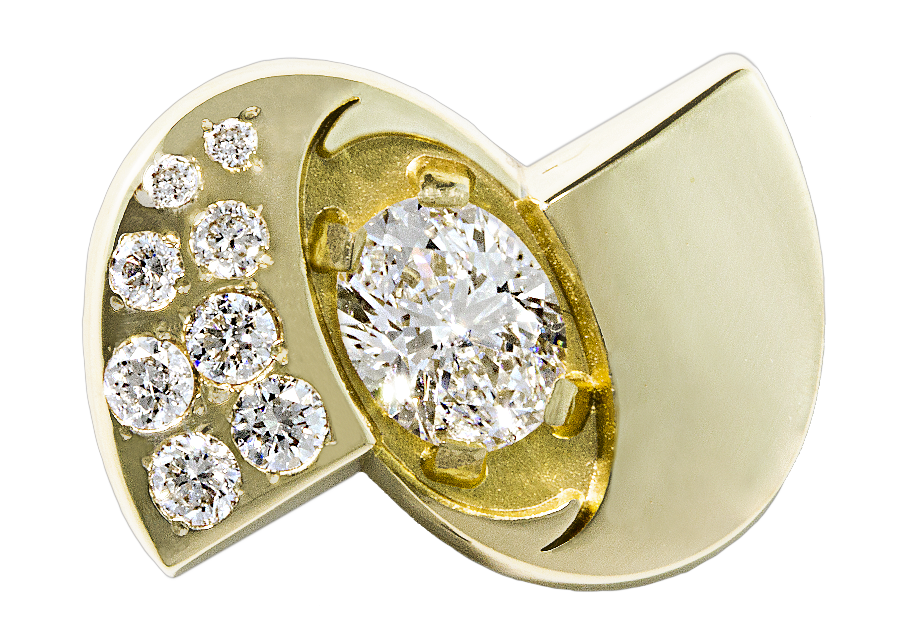
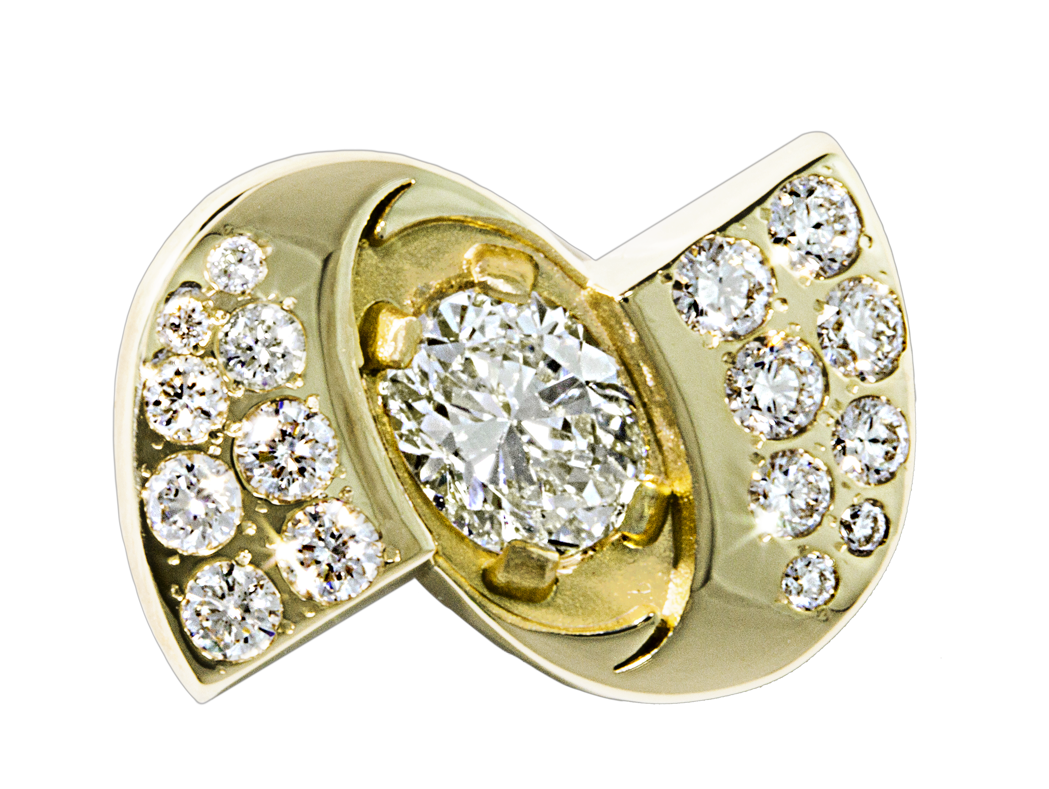
8
Profit Center
Chairman’s Club Bonuses
Earn big lifestyle bonuses as you become one of Unicity’s top leaders.
Rank |  | Bonus Value
Double Diamond |  | $150,000
Triple Diamond |  | $500,000
Crown Diamond |  | $1,000,000
*Read compensation plan for rules and qualifications.

Slide 25
Additional Enhancements to
Bring Alignment
PV has been dropped to 100 PV to earn commissions
Auto-Refill is no longer required to earn commissions
500 TV and 100 PV is required to earn Infinity Bonuses
Sr. Manager is 2000 OV with 3 legs of 500 OV
Director is 5000 OV with 3 legs of 1000 OV

Slide 26
The Power of Duplication
Month 1
You
(250 PV)
Rank:
Manager (1000 OV)
Maria
(250 PV)
Joe
(250 PV)
Jose
(250 PV)
Month 1 Earnings: $225

Slide 27
The Power of Duplication
Month 2 (Duplicate Month 1)
You
(250 PV)
Rank:
Sr. Manager
Maria
(250 PV)
Joe
(250 PV)
Jose
(250 PV)
Alex
(250 PV)
2500 PV
250 PV
250 PV
250 PV
250 PV
250 PV
250 PV
250 PV
250 PV
Month 2 Earnings: $392
Rebate = $12.50
Fast Start on Alex = $75 (250 x 30%)
Fast Start on 9 new second generation people = $67.50 (2250 x 3%)
Infinity Bonus on Maria, Joe and Jose’s PV = $37.50 (750 x 5%)
Sr. Manager Bonus $200

Slide 28
The Power of Duplication
Month 1
You
(500 PV)
Rank:
Sr. Manager (2000 OV)
Maria
(500 PV)
Joe
(500PV)
Jose
(500 PV)
Month 1 Earnings: $650
$450 in Fast Start Bonuses
$200 in Senior Manager Bonuses

Slide 29
The Power of Duplication
Month 2 (Duplicate Month 1)
You
(250 PV)
Rank:
Director
Maria
(250 PV)
Joe
(250 PV)
Jose
(250 PV)
Alex
(500 PV)
500 PV
500 PV
500 PV
500 PV
500 PV
500 PV
500 PV
500 PV
500 PV
Month 2 Earnings: $1035
Rebate = $12.50
Fast Start on Alex = $150 (500 x 30%)
Fast Start on 9 new second generation people = $135 (4500 x 3%)
Infinity Bonus on Maria, Joe and Jose’s PV = $37.50 (750 x 5%)
Sr. Manager Bonus $200
Director Bonus $500

Slide 30
The Time is Now!
Join Us in the ….
Big text paragraph

Slide 31
Main Title
Sub Title
Small text paragraph

Slide 32
Main Title
Sub Title
Item 1
Item 2
Item 3
Sub Item 1
Sub Item 2

